Slide 1
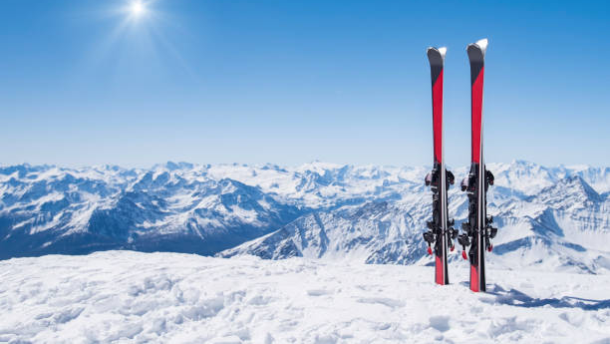


Big Mountain Resort
Ticket price strategy

Slide 2
Overview
Current ticket price: $81.00
New addition/investment: $1,540,000 (new chair lift to help increase distribution of visitors across the mountain).
Proposed business solutions:
Permanent closure of up-to 10 least used runs.
Increase of vertical drop by 150ft on the current longest trail (require additional chair lift).
Scenario 2 + include 2 acres of snow making (require additional chair lift + snow making machine for new area)
Increase longest run by 0.2 mile to boast 4 miles length (requires additional snow making coverage of 4 acres)

Slide 3
Key Findings
Big Mountain compares highly to other resort’s features that seem to be most correlated with higher ticket price.
Our model indicated that the price should be $95.87 vs current $81.
The proposed business solutions provided the following insight and results:
Closing 1 run = no difference. Close up-to 5 runs without significant change in ticket price with a relative drop in revenue. Any further drop of runs result in much lower ticket prices and 3x loss of revenue.
Increasing the vertical drop by 150 feet would support a price increase of $8.61 and would increase the revenue to around $15 million.
Scenario 2 + adding snow making over 2 acres would support a price increase of $9.90 per ticket and would generate a total of $18.5 million revenue.
Last proposal had no effect on price nor revenue.

Slide 4
Recommendation
Based on the significant increase in revenue if the longest run is extended another 150ft this would potentially be the best business option/decision.
However, further analysis should be performed with additional data such as but not restricted to:
Price to operate a new chairlift (needed to bring skiers up those extra 150ft)
Price of maintenance to groom skiable acreage
Cost of adding additional snow making capacity
Current operational cost of maintenance and lift availability on the least used runs that might be closed.

Slide 5

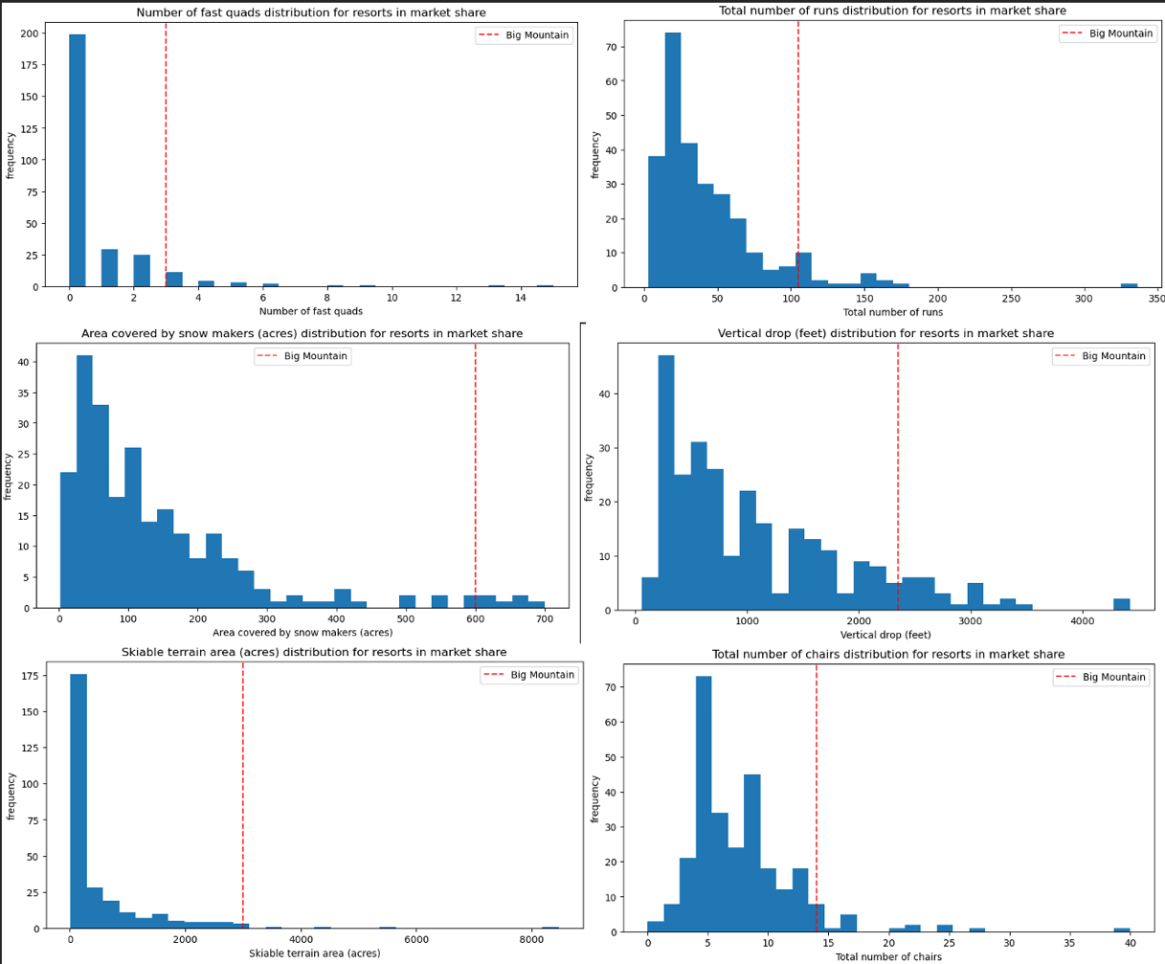
Modeling Results
Top 4 features correlated with pricing:
Fast Quads
Runs
Snow Making_ac
Vertical drop
5th and 6th features include Skiable terrain and total chairs
Big Mountain is within the top resorts that provide guests these top features.

Slide 6
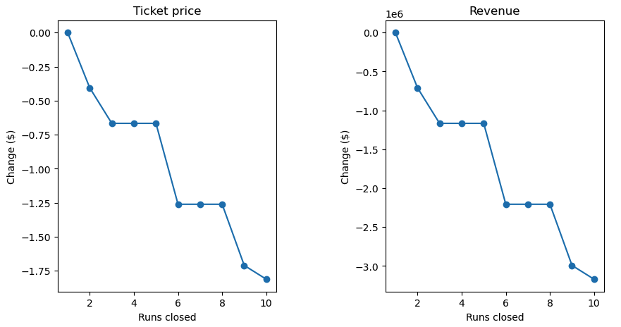
Modeling Results cont’
Scenario 1 review:
Closing 1 run has no effect on either price or revenue.
Closing 3-5 runs reflects the same loss in price (~0.75/ticket) and revenue (~1.26 million/season).
Closing 6-8 runs nearly doubles the loss in ticket and revenue.
Closing 10 runs creates a loss of ~2/ticket and over 3 million/season.
Its important to note: This outcome and analysis is only taking into account data provided.
Loss in revenue in this model is produced only by the loss of support for ticket price from model.

Slide 7
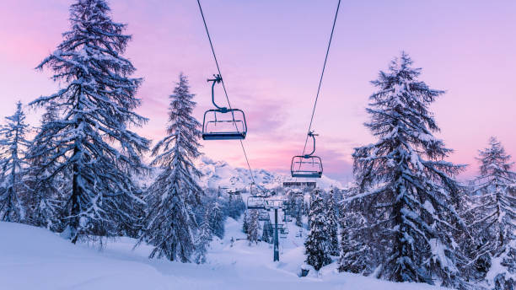
Conclusion
Our model indicates that Big Mountain is not capitalizing on its features and facilities as it falls within the top amongst competitors for features. The current price is off by ~$14.87.
Based on the business solutions, adding 150ft to the current longest run provides the closest justification for price change with an increased $8.61/ticket and total revenue of 15 million for the season.
Note: this model does NOT include expense variability that might be created from closing runs, extending overall skiable terrain, adding snow making coverage, adding additional chair lifts, and other operational costs that will influence revenue beyond just ticket price variability.
Final recommendation: Maintain the current model as top features have been identified and model seems to provide calibrated results for price changes. However, improve the model for better business decision making by adding operational costs that will vary given the provided scenarios.
z

